Slide 1
Cooperation programme Interreg V-A Slovenia-hungary
Aleš Mrkela, Managing Authority
Gornja Radgona, 29.08.2017

Slide 2
Programming
Evaluation of situation in programme area
Setting-up intervention logic and programme strategy
Selection of priorities, definition of activities and indicators
Financial planning
Setting-up of institutional framework and start of the programme
Ex-ante
Consultations
18.9.2015
Confirmation of
programme by EC

Slide 3
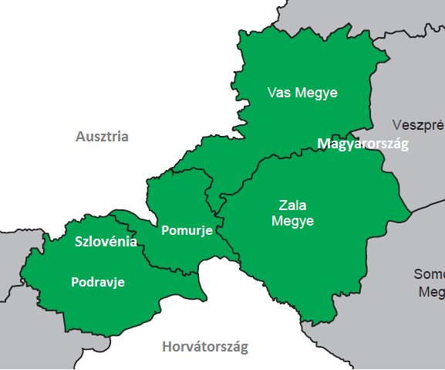
Programme area
Slovenia: Podravje and Pomurje region
Hungary: Vas and Zala Counties
10.658 km²
caa. 1 million of inhabitants

Slide 4
Allocation - ERDF Funds
P 1
Attractive region
10 M EUR
P 2
Cooperative region
3,29 M EUR
Total budget
14.795.015 EUR ERDF
P 3
Technical assistance
1,5 M EUR
Cofinancing rate
85 %
4

Slide 5
Fundamentals of Intervention logic
Common characteristics that define strategy
Rich natural nad cultural heritage
Important and concentrated turistical potential
Existing institutional connections
Dual nature: developed centers (turistical magnets) less developed regions
Emigration
Deficiencies in cooperation (ex. transport, environment, energetics, employment)

Slide 6
Overal objective of the programme
„The overall objective of the Programme is to become an attractive area for living, working, investing, undertaking trough better capitalizing on existing natural and cultural assets in tourism catalyzing the development of the whole region on one hand and on the other jointly addressing those common problems which call for common solutions at CBC level.“
6

Slide 7
Intervention logic of the programme / projects
Programme priority axis
Priority investment
Specific objectives
Result indicator
Overal objectives of the project
Main result of the project
Investments which are subject of support in priority axis
Programme output indicator
Specific objectives of the project
Project output indicator
Intervention categories
PROGRAMME
PROJECT
7

Slide 8
1st Priority axis
6th Thematic objective, 6c thematic investment: » Conserving, protecting, promoting and developing natural and cultural heritage.«
Specific objective of the programme:
To increase attractiveness through the diversification and cross-border integration of the sustainable touristic offer in the programme area
Cross-border integration and diversification of sustainable turistic offer
Protection of natural and cultural heritage
Development of sustainable touristic offer in the programme area, by supporting the protection/conservation of the natural and cultural resources and by the generation/promotion of new, sustainable products which are based on these local resourceses with connection to main turistic offer
8

Slide 9
Programme philosophy: strong programme orientation
Aim of lowering regional differencies increase competitivness of rural areas development of work intensive sectors modern and integrated rural turism offer
9

Slide 10
Examples of actions
Jointly developed plans and strategies for the sustainable utilization of cultural and natural heritage for better use of the touristic potential of the rural parts of the programme area
Small scale investments regarding sustainable utilization of cultural and natural heritage by promoting environmental friendly technologies and/or by implementation of small scale renovation / revitalization and conservation of cultural and natural heritage
Improving accessibility to cultural and natural heritage sites as part of joint tourism measures in justified cases
Awareness raising actions and/or campaigns related to improve the level of knowledge and education about the elements of cultural and natural heritage existing in the programme area
Regional cross-border cooperation in tourism destination management, development of regional trademark and quality management systems, common branding and promotion, joint organization and participation in fairs and exhibitions, transfer of know-how, etc.,
Supporting diversification of quality cross-border tourism services offered in the area
Joint development of new, innovative tourism products and services for the rural, less developed areas
Trainings and capacity building for the local entrepreneurs and/or employees in developing relevant skills related to tourism
Improvement of the usage of modern (communication) tools and promotion activities
Establishment of organizations and/or partnership networks with cross-border relevance

Slide 11
Potential beneficiaries
Local, regional public and state public administrations/institutions, and their organizations, such as national/natural park administrations, forest authorities, cultural institutions, museums, local action groups, organizations competent in the field of transport, etc.
State owned companies
NGOs, non-profit organizations (including legal entities established by private law with non-profit status and purpose of operation), tourism associations, tourism destination management organizations
In Hungary, church institutions/organizations
Chambers and professional associations
EGTCs.

Slide 12
2nd Priority axis
11th Thematic objective, 11b thematic investment: „Enhancing institutional capacity of public authorities and stakeholders and efficient public administration by promoting legal and administrative cooperation and cooperation between citizens and institutions.“
Specific objective of the programme:
To increase the capacity for cooperation in order to reach a higher level of maturity in cross-border relations.
The exchange of experience in innovative approaches, tools and working methods, know-how, best practices, empowerment, advocacy and other forms of capacity building
Improvement of institutional capacity
Improvement of public services through cross border relations
12

Slide 13
Programme philosophy: strong programme orientation
Catalisation of institutional cooperation joint problem solving of common problems exchange of experience, long lasting institutional relations better public services
13

Slide 14
Examples of actions
The projects shall seek to create sustainable, strategic partnerships in the sectors tackled. Cooperation may address different fields such as:
environmental protection, energy efficiency, renewable energy
social services (social innovation), healthcare by addressing the increasing problems the area is facing in the field of societal challenges, as ageing, depopulation, etc.
employment through developing organizational processes, joint measures and initiatives meant to increase the quality of the public services in the sector
spatial planning, regional development, through better coordinating and developing more efficient and effective policies in the field
accessibility, especially harmonization of cross-border public transport
civil protection and common risk prevention and management, by increasing the capacity to prevent and to intervene in case of manmade or natural emergency situations
cultural cooperation, through increasing the institutional capacity of the stakeholders for the preservation of the multi-ethnic cultural environment of the programme area

Slide 15
Potential beneficiaries
Local, regional and state level public administrations/institutions and their organizations
NGOs
Educational institutions, including rehabilitation centers
Healthcare institutions, providers of social services
Labor force offices, different forms of professional chambers
Cultural institutions and organizations
Stakeholders in the field of risk prevention and emergency management
EGTCs.

Slide 16
State of play
Open call for proposals was published in December 2015 and is still open
Deadlines for submission within the Open Call
Already 3 rounds were processed
4th deadline is 14th of November 2017
13 projects supported
9 from 1st priority in total of 8.639.769,93 EUR ERDF
4 from 2nd priority in total of 1.070.830,77 EUR ERDF

Slide 17
What kind of projects are currently supported?
Projects developing connections between rural areas
Hiking, biking and trail paths/parks establishment
Leisure activities parks
Projects improving overnight capacities
Projects connecting turistical supply
Interinstitutional capacity building
Projects directed towards own institutional capacity building

Slide 18
ERDF Funds remaining
4th Deadline
1st priority – 1.360.230,07 EUR ERDF
2nd priority – 2.224.184,23 EUR ERDF
Even 5th deadline is expected for priority 2.

Slide 19
Current achievement
66 different institutions supported
57 partner reports submitted (1st and 2nd reports already in the pipeline)
518.423,83 EUR ERDF reported in the system so far
First outputs and deliverables starting to emerge

Slide 20
Thank you for your attention.
QUESTIONS ?

